Slide 1

Huggingface - Transformers
Ali Hürriyetoğlu
SICSS-Istanbul
July 4, 2023

Slide 2
Huggingface
https://huggingface.co/
https://huggingface.co/docs/transformers/index
https://github.com/huggingface/transformers

Slide 3
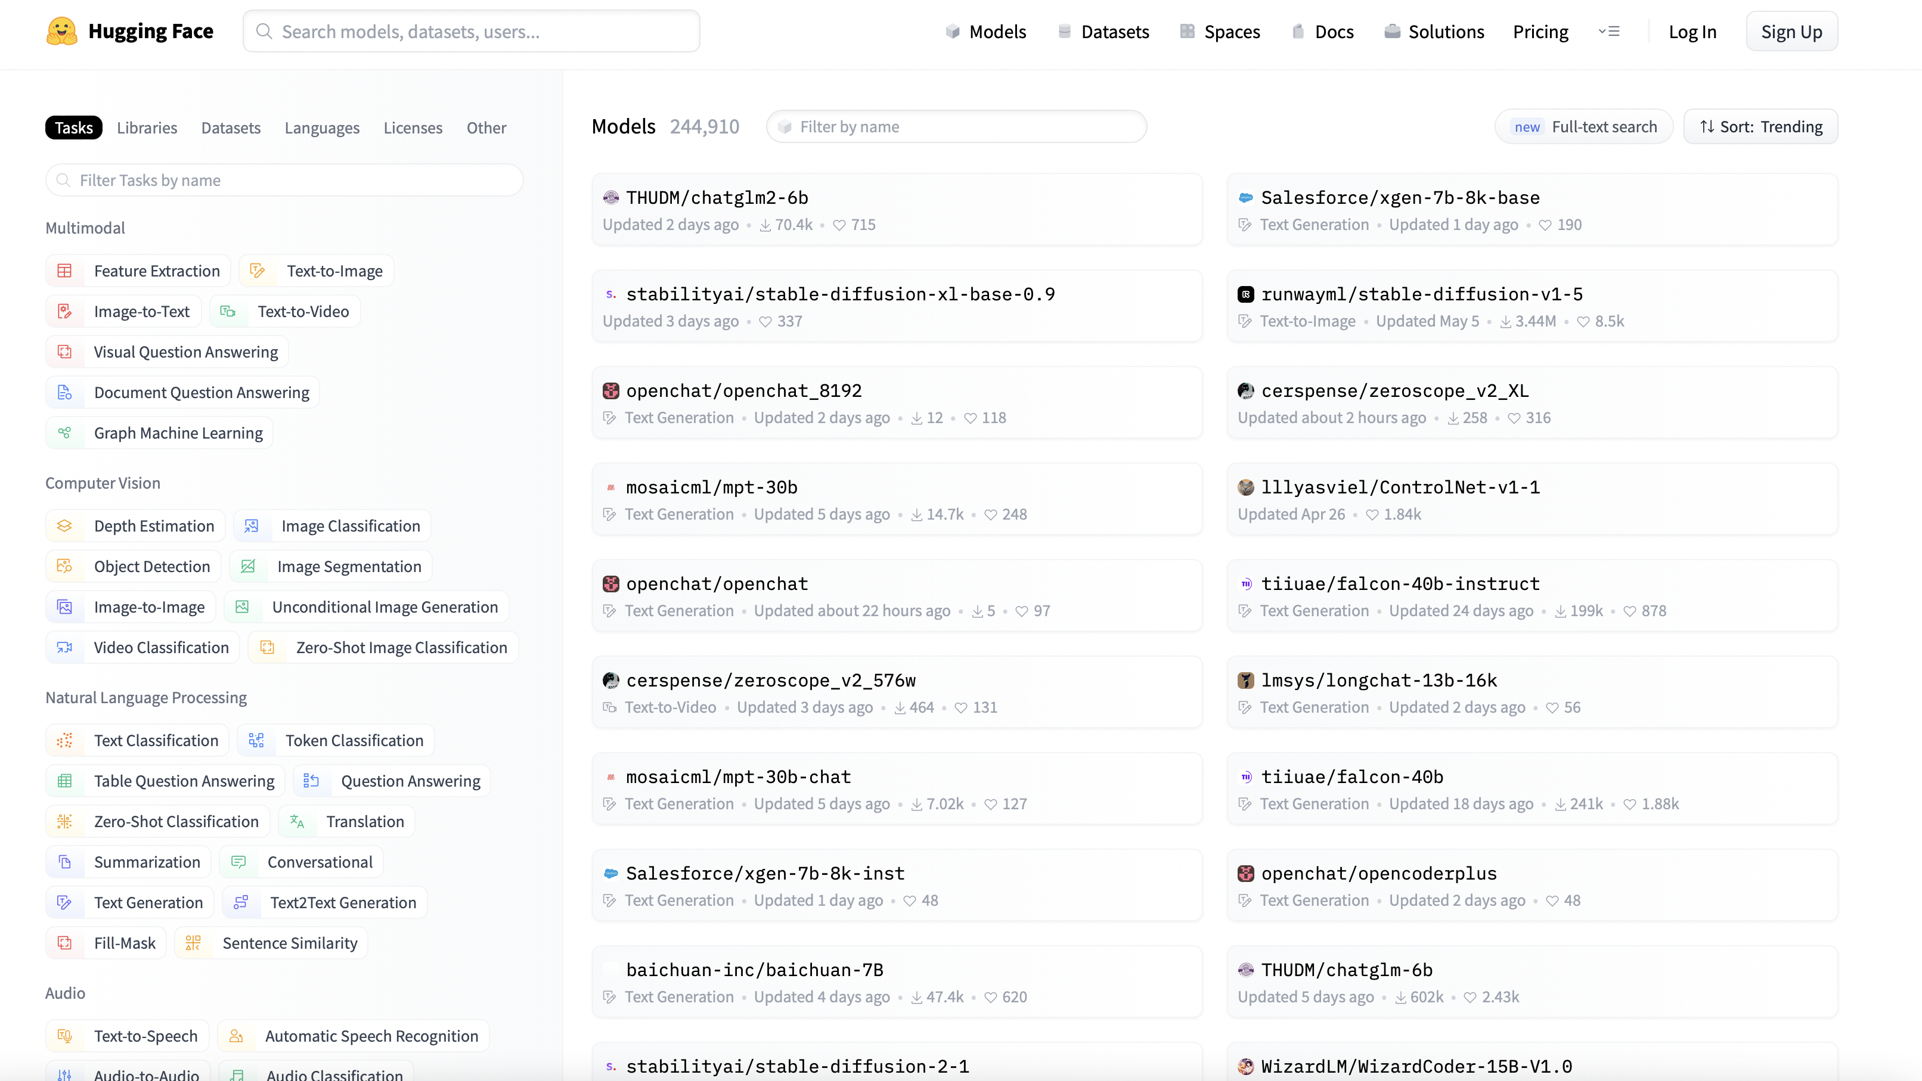
Ref: https://huggingface.co/models

Slide 4
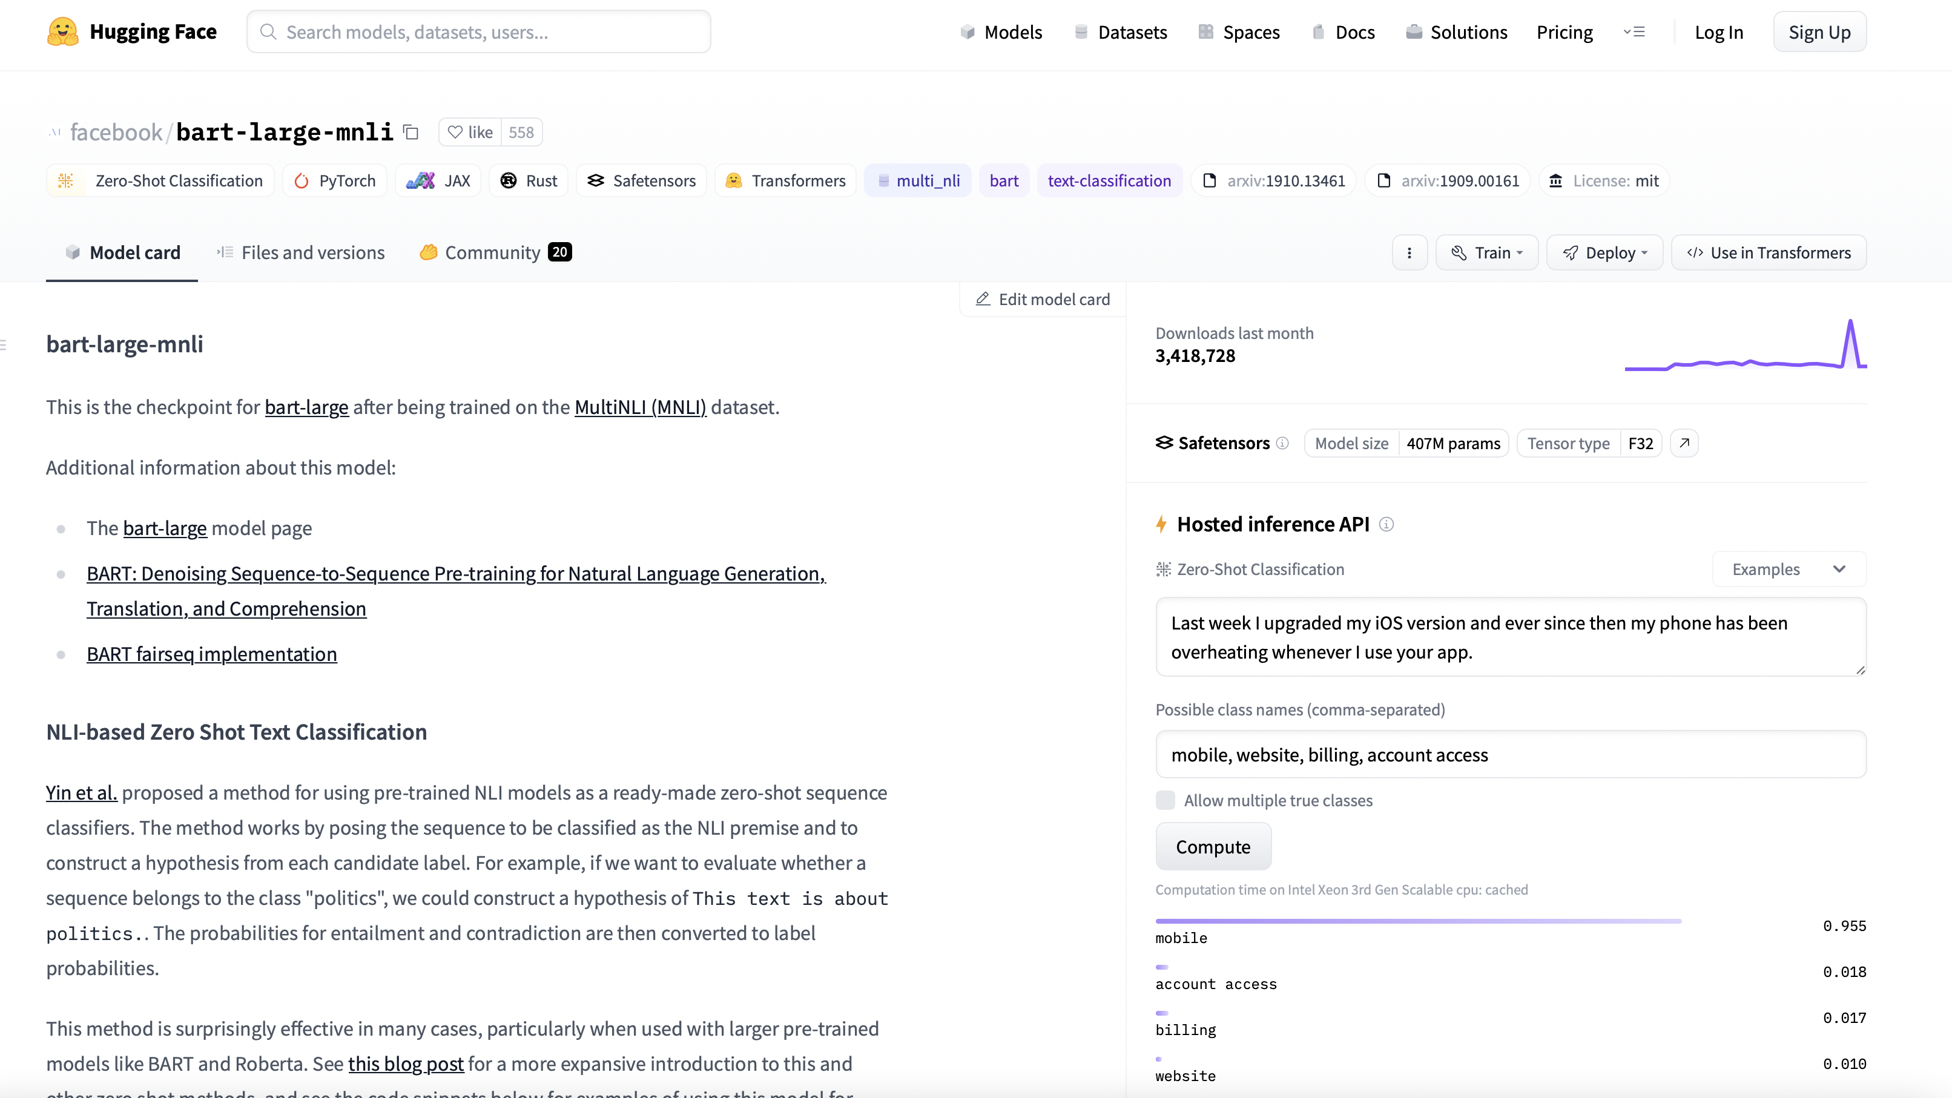
Ref: https://huggingface.co/facebook/bart-large-mnli

Slide 5
Sample notebooks: https://github.com/huggingface/transformers/tree/main/notebooks
Study first two on Colab:
Quicktour of the library
Summary of the tasks

Slide 6
Thanks for listening!
What questions do you have?
Reach me at: ali.hurriyetoglu@gmail.com

